Slide 1
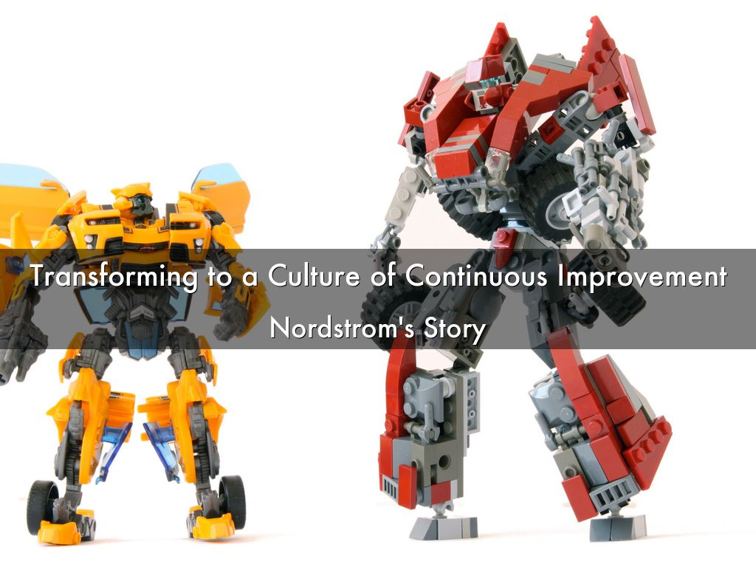
Photo by Louis K. - Creative Commons Attribution-ShareAlike License https://www.flickr.com/photos/49644719@N06
Created with Haiku Deck

Slide 2

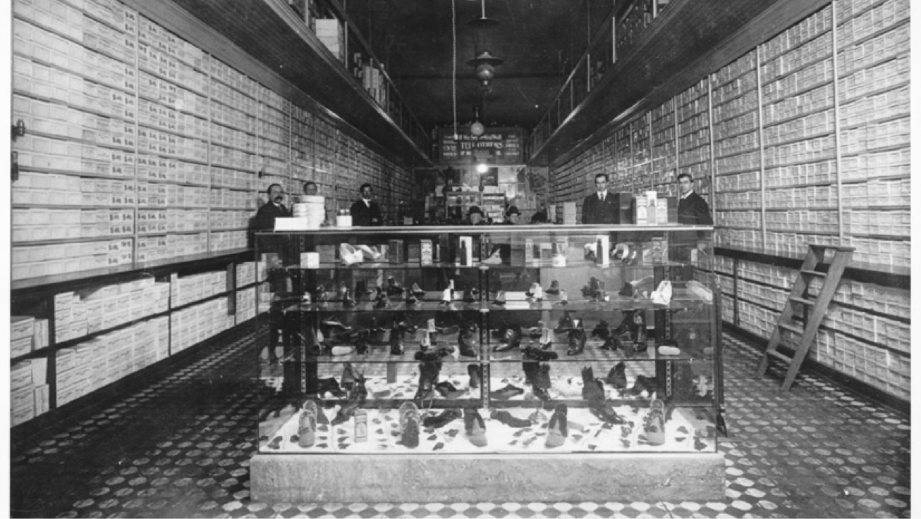

63,000 employees (1,800 technology)
$12.5B in revenue

Slide 3



Context: Our Business & Technology Challenge
Our business ambitions have dramatically increased in terms of complexity, scale & speed and technology is increasingly critical in all parts of our business
.com
.com
CUSTOMER
CUSTOMER
Technology as The Key Enabler

Slide 4

Photo by zilverbat. - Creative Commons Attribution-NonCommercial License https://www.flickr.com/photos/25228175@N08
Created with Haiku Deck

Slide 5
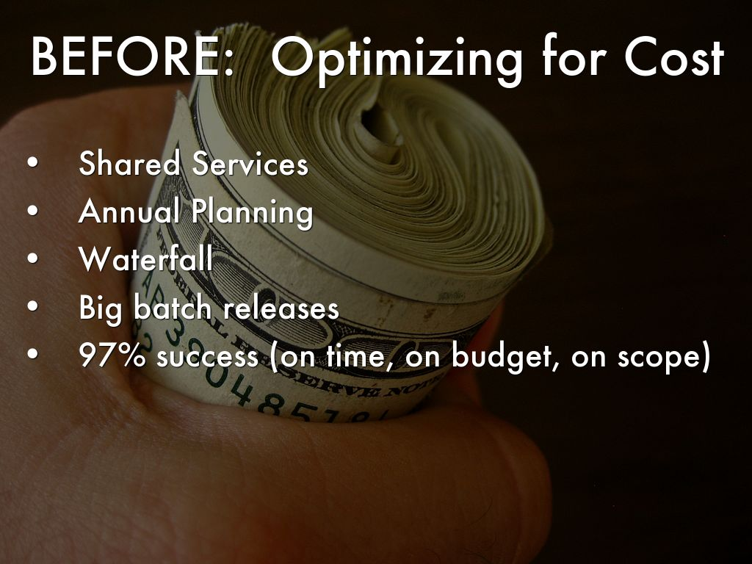
Photo by 401(K) 2013 - Creative Commons Attribution-ShareAlike License https://www.flickr.com/photos/68751915@N05
Created with Haiku Deck

Slide 6
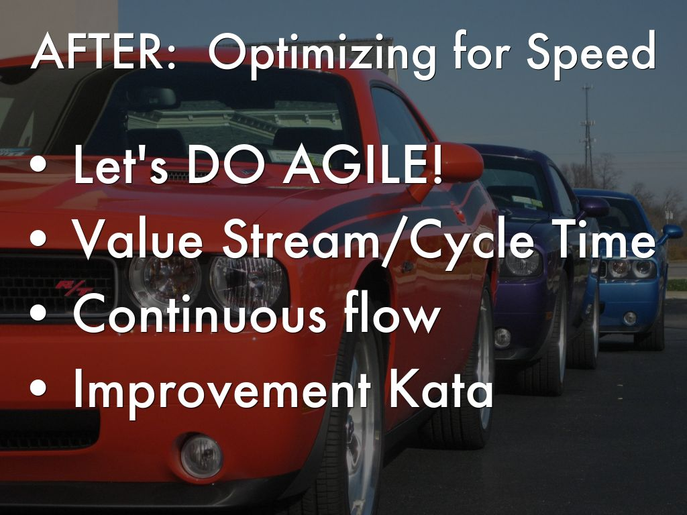
Photo by zombieite - Creative Commons Attribution License https://www.flickr.com/photos/78593866@N00
Created with Haiku Deck

Slide 7

Photo by umjanedoan - Creative Commons Attribution License https://www.flickr.com/photos/8271124@N03
Created with Haiku Deck

Slide 8
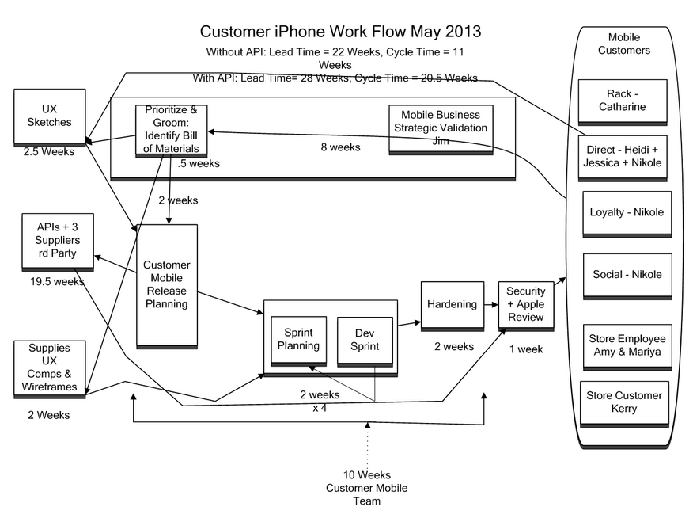

Slide 9
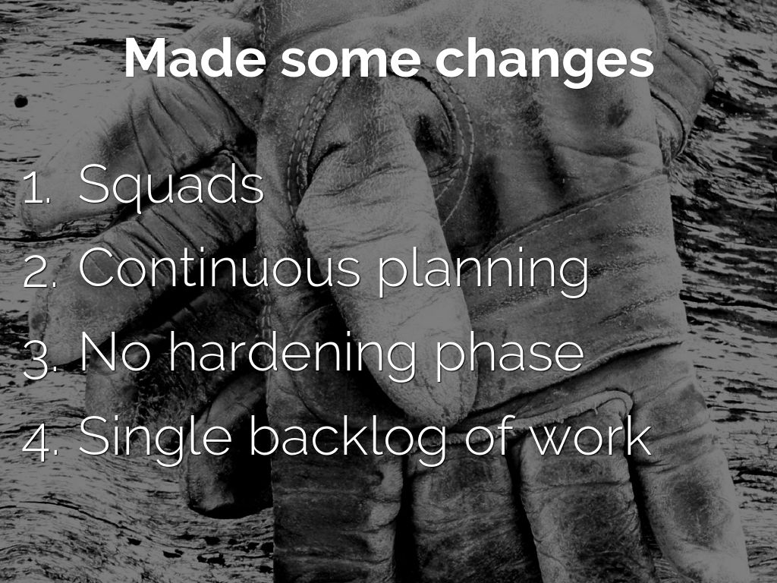
Photo by amishsteve - Creative Commons Attribution-NonCommercial-ShareAlike License https://www.flickr.com/photos/61414741@N00
Created with Haiku Deck

Slide 10
Quality & Throughput
June 13
Sep 13
Dec 13
Mar 14
June 14
Sep 14
Bugs
Features per month

Slide 11
RESULTS:
DEPLOYMENT/RELEASE FREQUENCY
= BEFORE
= NOW

Slide 12

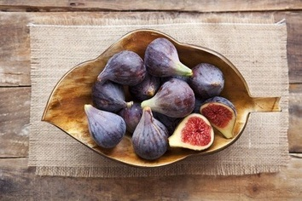

Slide 13
STORY: RESTAURANT RE-CONCEPTS
Some context:
11 re-concepts completed in 2013
44 planned in 2014
30+ high impacting incidents in 2 months
Business leader phone call – “you need to triple the size of your team….”
My response – “that’s one way to solve it….”

Slide 14
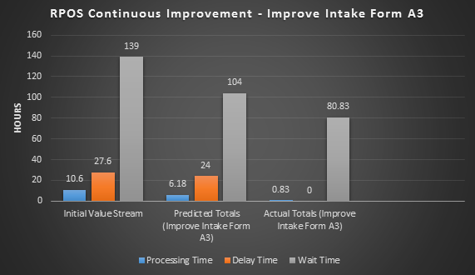
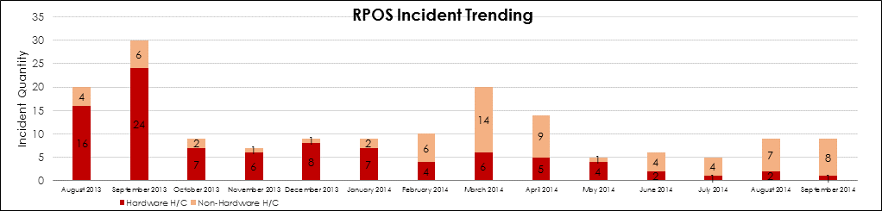
RESULTS: RESTAURANT CONTINUOUS IMPROVEMENT

Slide 15
What I want to leave you with….
PEOPLE - #1 asset
Everything we build should be about the customer – ask ourselves “would the customer value that?”
Passionate belief in continuous improvement as a critical component of how we get work done in the future – need to create a learning culture
Be persistent….”keep going”
Leaders HAVE to evolve

Slide 16
If I could wave a magic wand, every leader in the organization would….
Honor Reality
Become a student - Go & See
Become a teacher – Learning Culture
Problem Solving
Improvement Kata
Lead by Example (actions matching words)
Ask Why and Articulate Why

Slide 17
I could use help with….
Measurement, specifically throughput
Case studies
Stories (good & bad)

Slide 18
QUESTIONS?

